Slide 1
TOPAZ
Animal Exports and Shipping

Slide 2
Contacts
Animal Exports and Imports (CMAnimalImportsExport@ouhsc.edu)
Animal Exports and Imports
Animal Transporting Questions
OUHSC Contact information for receiving institutions
General Animal Export/Import Questions
Animal Ordering, Billing, and Census Office(compmedhousingrequests@ouhsc.edu)
Animal Transfers
Animal Orders
Cage Cards
Vendor Additions
Account Additions and Issues
Strain/Stock/Breed Additions
Account and Program Support (comp-med@ouhsc.edu)
TOPAZ Elements Accounts and Access
TOPAZ Elements Application Support
Website Feedback/Questions (acup.ouhsc.edu)

Slide 3
Export Process guidelines

Slide 4
Prerequisites to animal Export requests
The PI must have:
An approved IACUC protocol.
If a MTA is required, please complete prior to export request.
All exports will include costs involved with the exporting process, costs may vary dependent on time spent. This includes, but not limited to, communication with outside institution, gathering of required documents, health checks prior to shipping, and crating of animals to ship.
If you do not have the contacts for the receiving institution, such as Veterinarian and shipping coordinator. Please contact the PI to which you are shipping for the information. DCM will not always have the contacts for all outside institutions.

Slide 5
Animal Exports Requests
Please follow the link below to submit an export request.
DCM Animal Export request

Slide 6
demonstration of placing an animal Export form

Slide 7
Animal export
Complete export OUHSC PI contact information as it is listed on the IACUC approved protocol.
If the contact information is not listed or incorrect, DCM will contact you with the corrections needed to process the request.

Slide 8
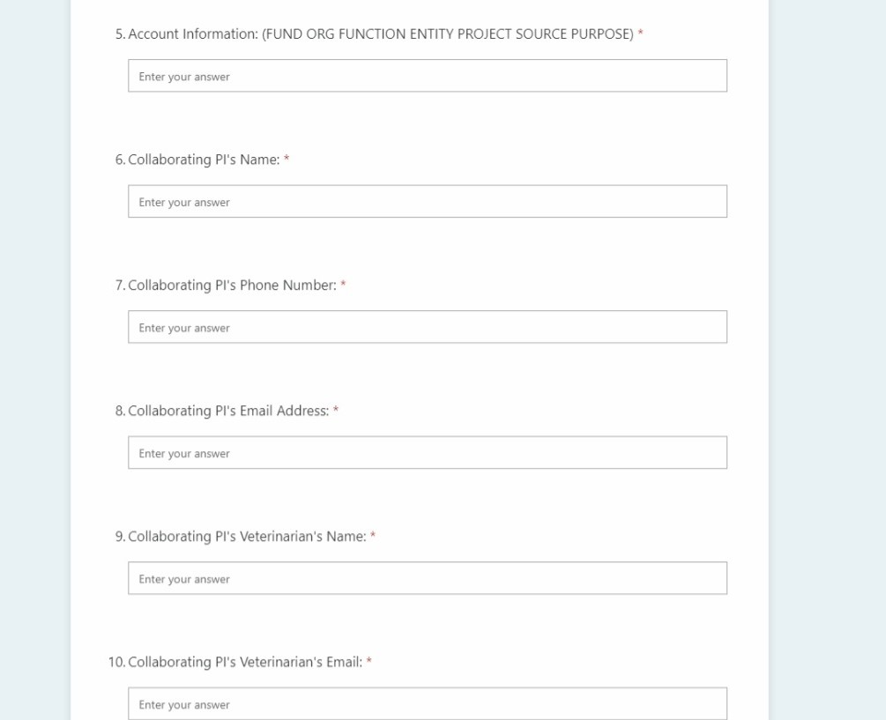
Animal exports cont.
Provide a valid CFS. If PI or lab staff do not know the correct account, contact your billing administration.
Enter in the receiving institution’s contact information.
If you do not have this information Please refer to slide 4.

Slide 9
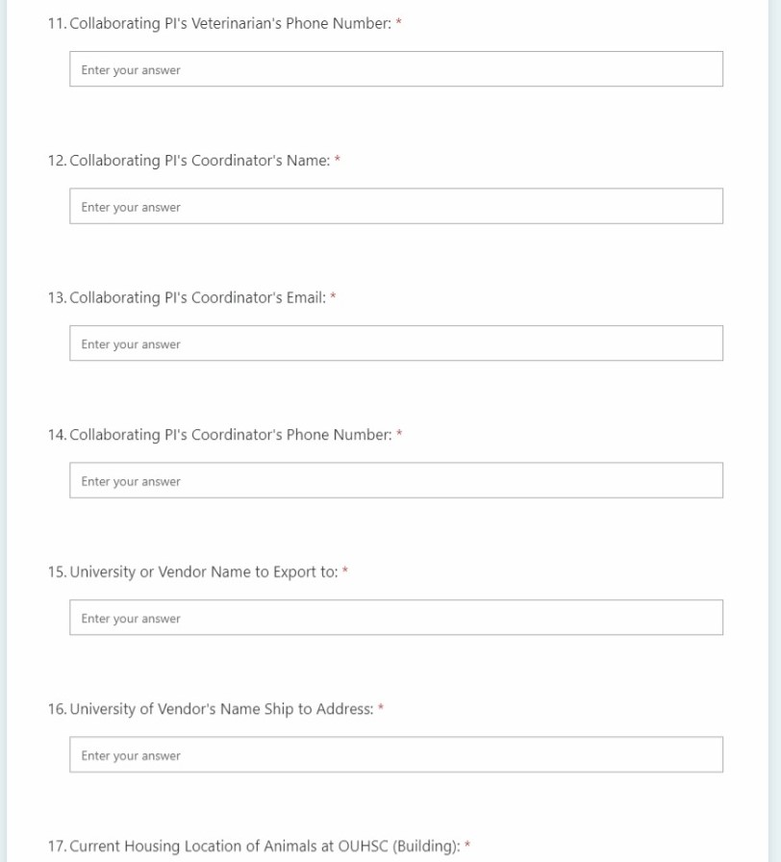
Animal exports cont.
Continue to enter the receiving institution contact information.
If you do not know the exact shipping address for your export, please state the city and state or city and country.
If you do not have this information Please refer to slide 4.

Slide 10
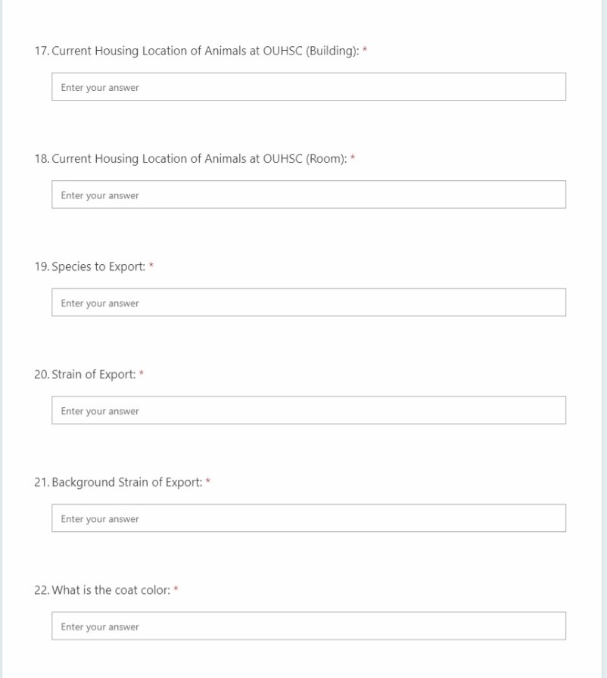
Animal exports cont.
Enter the OUHSC housing location, building and room.
Species and Strain for export.
Background strain of animals to be shipped.
Coat color of animals to be shipped.

Slide 11
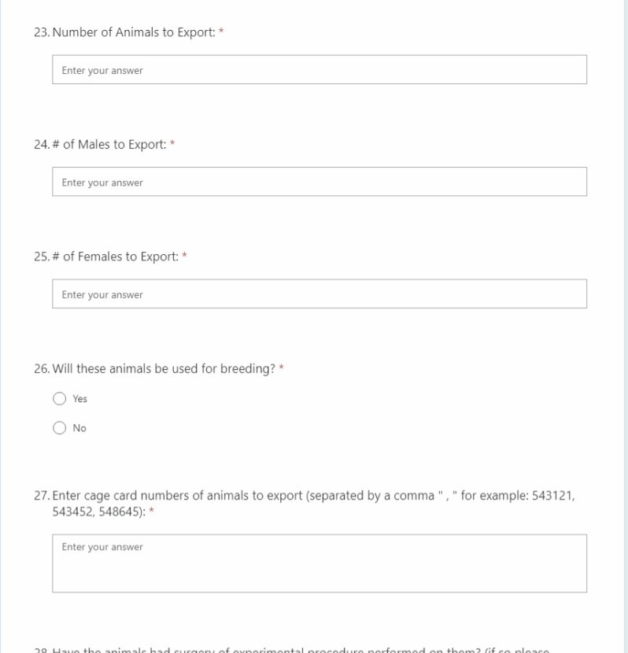
Animal exports cont.
Enter the total number of animals to ship.
Specify number of males and females.
Note if the animals will be used for breeding.
Enter the cage card numbers for shipment.
DCM understands that the numbers may change from the original requests due to animals available at shipment approval.

Slide 12
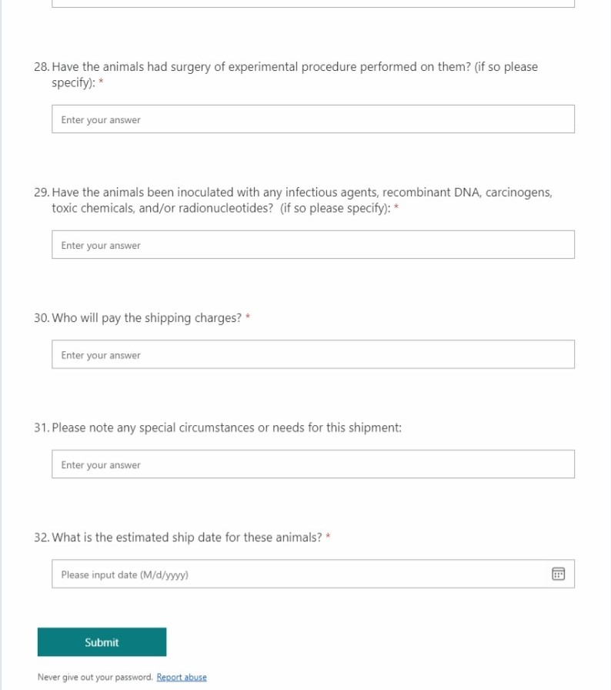
Animal exports cont.
If animals have had experimental procedures or inoculated with any of the items listed in question 28, please list all.
Specify who will pay the shipping charges. If OUHSC PI will pay, DCM will use our account an bill the PI.
Note additional special circumstances or needs for the shipment.
Enter the estimated ship date for export.
Please note, the estimated ship date heavily relies on temperatures, and approval from receiving institution.
Once you have completed the entire document, select submit. An email will be sent to DCM Exports/Imports of your request.

Slide 13
Export process

Slide 14
Export process Timeline
After initiation of the export request, DCM will contact the sending institution. DCM strives to contact the receiving institution within 72 hours of the request.
If the receiving institution is in need of a MTA, please refer to slide 4.
DCM will provide the receiving institution with the information that was supplied on the export form, with documents of our institution’s facility and health monitoring programs.
If any additional information is needed by the receiver, DCM will either request from PI, if needed, or send the requested information.
If the receiving institution requires additional testing, the PI or receiver will be responsible for all costs involved.
The process of review and approval of the animal times vary by institution.

Slide 15
Export process Timeline cont.
The process of review and approval of the animal times vary by institution.
After approval has been given, DCM will coordinate with receiving institution on shipper and arrival preference.
DCM will request that the PI or a lab member designate the cage(s) to be shipped with pink export shipping cards. You will be given instructions on where to collect these cards.
After cage(s) are labeled for export, please minimize handling of mice for shipment to ensure their health status remains in good condition for shipment.
Once cages are labeled DCM Veterinary staff will observe the health conditions of the animals.
Pending temperatures, shipment will be scheduled according to receivers guidelines. Animals will not ship during extreme heat or extreme cold. Expect slight shipment delays during Summer and Winter months.
Shipment scheduling will occur by DCM, PI will be notified of date and time animals are scheduled to ship.
Many institutions do not accept breeding pairs, pregnant females, or un-weaned pups. If the animals you wish to ship fall into any of those category’s, contact DCM immediately. This may delay your shipment.
The process of review and approval of the animal times vary by institution.

Slide 16
Questions on animal exporting

Slide 17
Questions on the process or general export guidelines? Please contact CMAnimalimportsexport@ouhsc.edu

