Slide 1
TOPAZ
Animal Imports and Housing

Slide 2
Contacts
Animal Imports (CMAnimalImportsExport@ouhsc.edu)
Animal Import Request Information
Billing, and Census Office(compmedhousingrequests@ouhsc.edu)
Animal Transfers
Animal Orders
Account Additions and Issues
Strain/Stock/Breed Additions
Account and Program Support (comp-med@ouhsc.edu)
TOPAZ Elements Accounts and Access
TOPAZ Elements Application Support
Website Feedback/Questions (acup.ouhsc.edu)

Slide 3
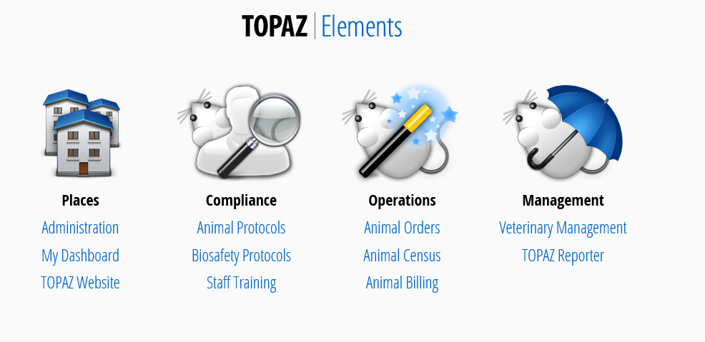
Animal Housing and Ordering
Comparative Medicine uses TOPAZ Elements Form for Animal Orders, Imports, and Housing.

Slide 4
Placing an animal IMPORT housing form

Slide 5
Prerequisites to animal IMPORTS IN TOPAZ
The PI must have:
An approved IACUC protocol with animals remaining. Under special circumstances, the DCM holding protocol may be approved for usage.
An active/approved account (email compmedhousingrequests@ouhsc.edu if account is not present when trying to order animals).
If a MTA is required, please start the process prior to submitting an import request.

Slide 6
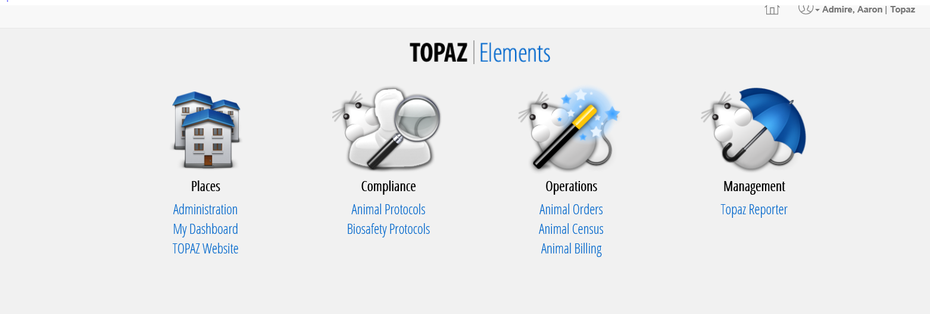
demonstration of placing an animal IMPORT housing form

Slide 7
Animal housing Form
You can submit an animal housing form in Topaz for any approved protocol. Animal orders can be scheduled for a single delivery or a standing order. The following tutorials explain how to create an order, housing form, and then schedule delivery.
How to fill Animal Housing Forms
Log into Topaz Elements (https://topaz.ouhsc.edu)
Under Operations, click on Animal Orders.

Slide 8
Animal Orders
Hover over “Orders” (Mouse Picture)
Click on “Create New Order”

Slide 9
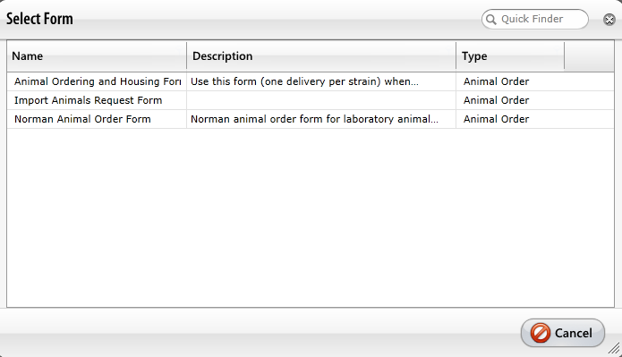
Animal Orders
Click on “Import Animals Request Form”
Use this form (one delivery per strain) when requesting animals to be housed in one of our Comparative Medicine Facilities. This is the only form needed when importing animals obtained from outside institutions and collaborating PI’s outside of OUHSC. New commercial vendors may also be treated as an import. Incomplete information will result in a delay in approval of the order.

Slide 10
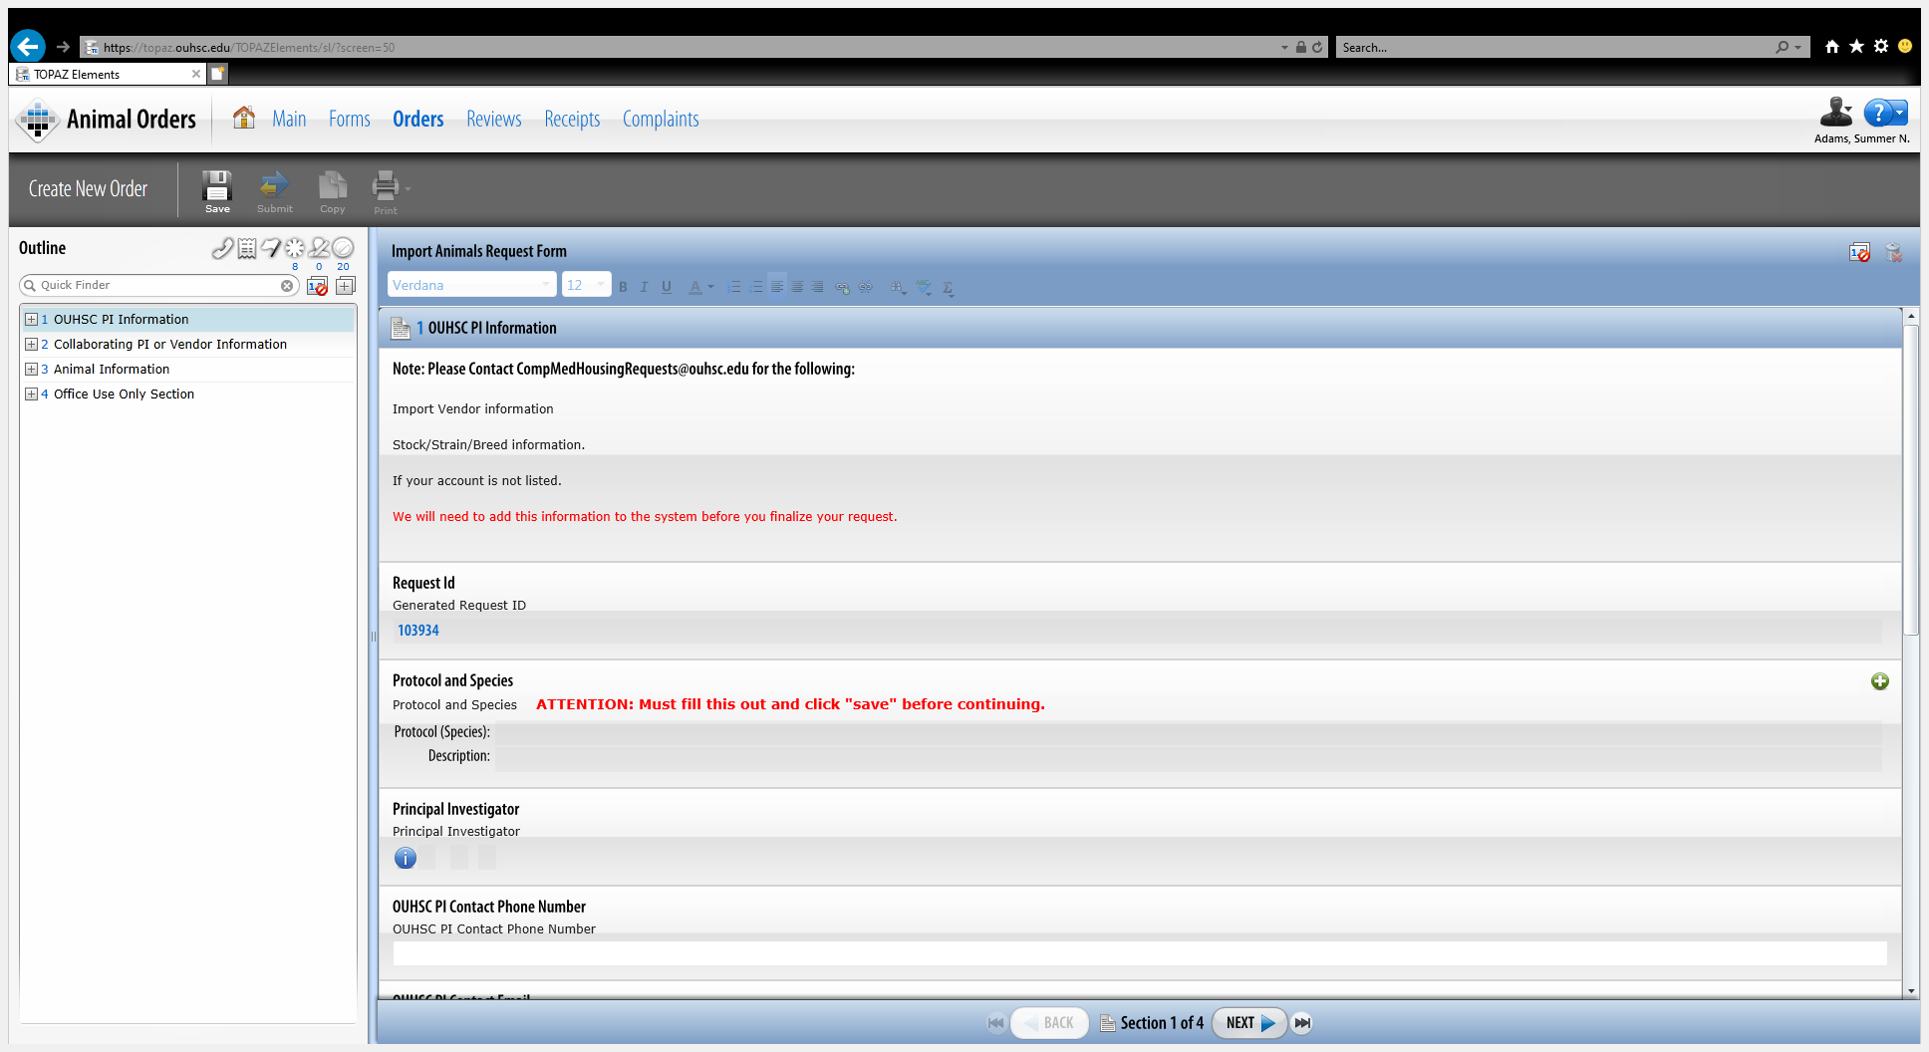
Form Questions
Form Sections
Notes:
After selecting the correct protocol the save button must be clicked before continuing. This will automatically populate the Principle Investigators name.

Slide 11
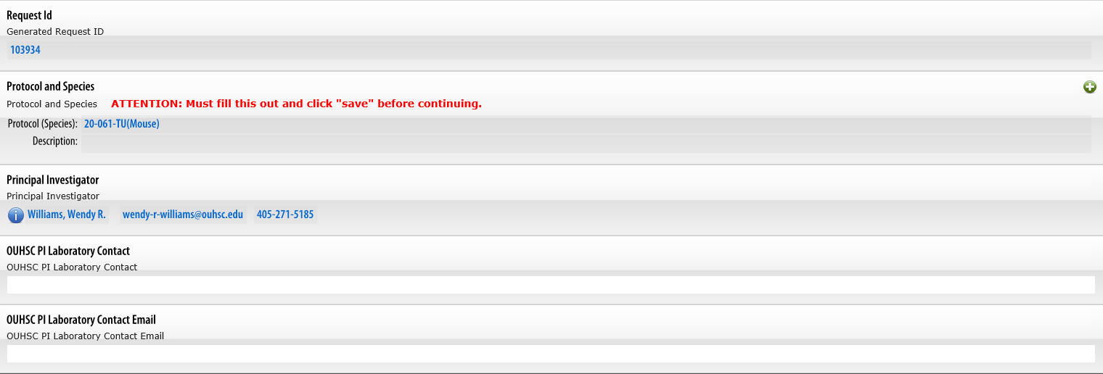
Animal Imports
Section 1:
Protocol Information
Request ID
Protocol and Species
Principal Investigatory
PI Lab Contact
PI Lab Contact Email

Slide 12
Click on the save button after filling out Protocol/Species, then click “next”
After filling out Protocol and Species, don’t forget to hit save!
Notes:
After filling out Protocol and Species, don’t forget to hit save!

Slide 13
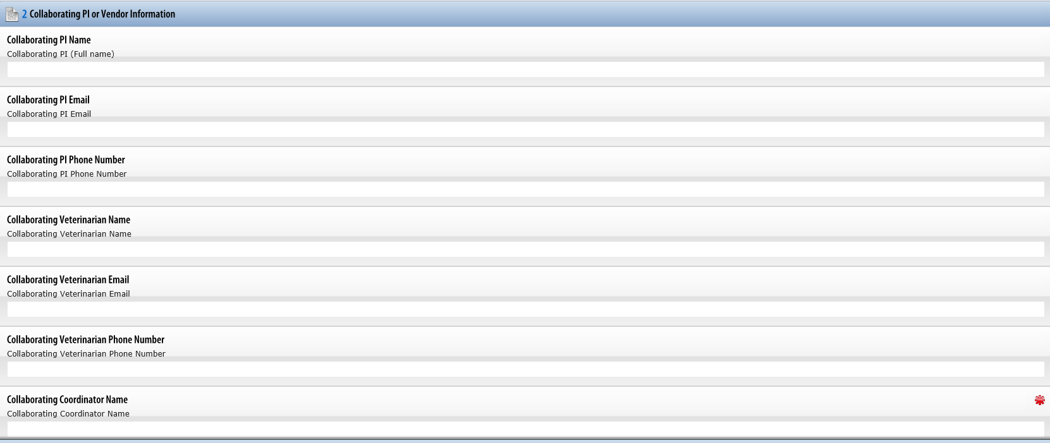
Section 2:
Collaborating PI or Vendor Information
Collaborating PI:
Name
Email
Phone number
Collaborating Veterinarian:
Name
Email
Phone Number
Collaborating Coordinator:
Name *REQUIRED*
Email *REQUIRED*
Phone Number

Slide 14
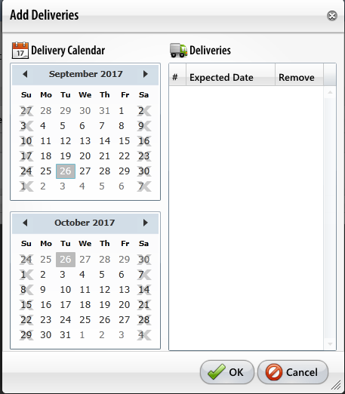
Section 3
Animal Information
Select the vendor and country of origin. Proceed to select your desired/estimated delivery date.
If multiple deliveries are requested, you may select however many deliveries you wish for the order. Every delivery must be the same strain, and age/weight requirement. You may even enter multiple strains per order with the same delivery date if necessary, just select the date and create as many deliveries as requested.
Please note import time frames may vary, the average process can take up to three weeks.

Slide 15
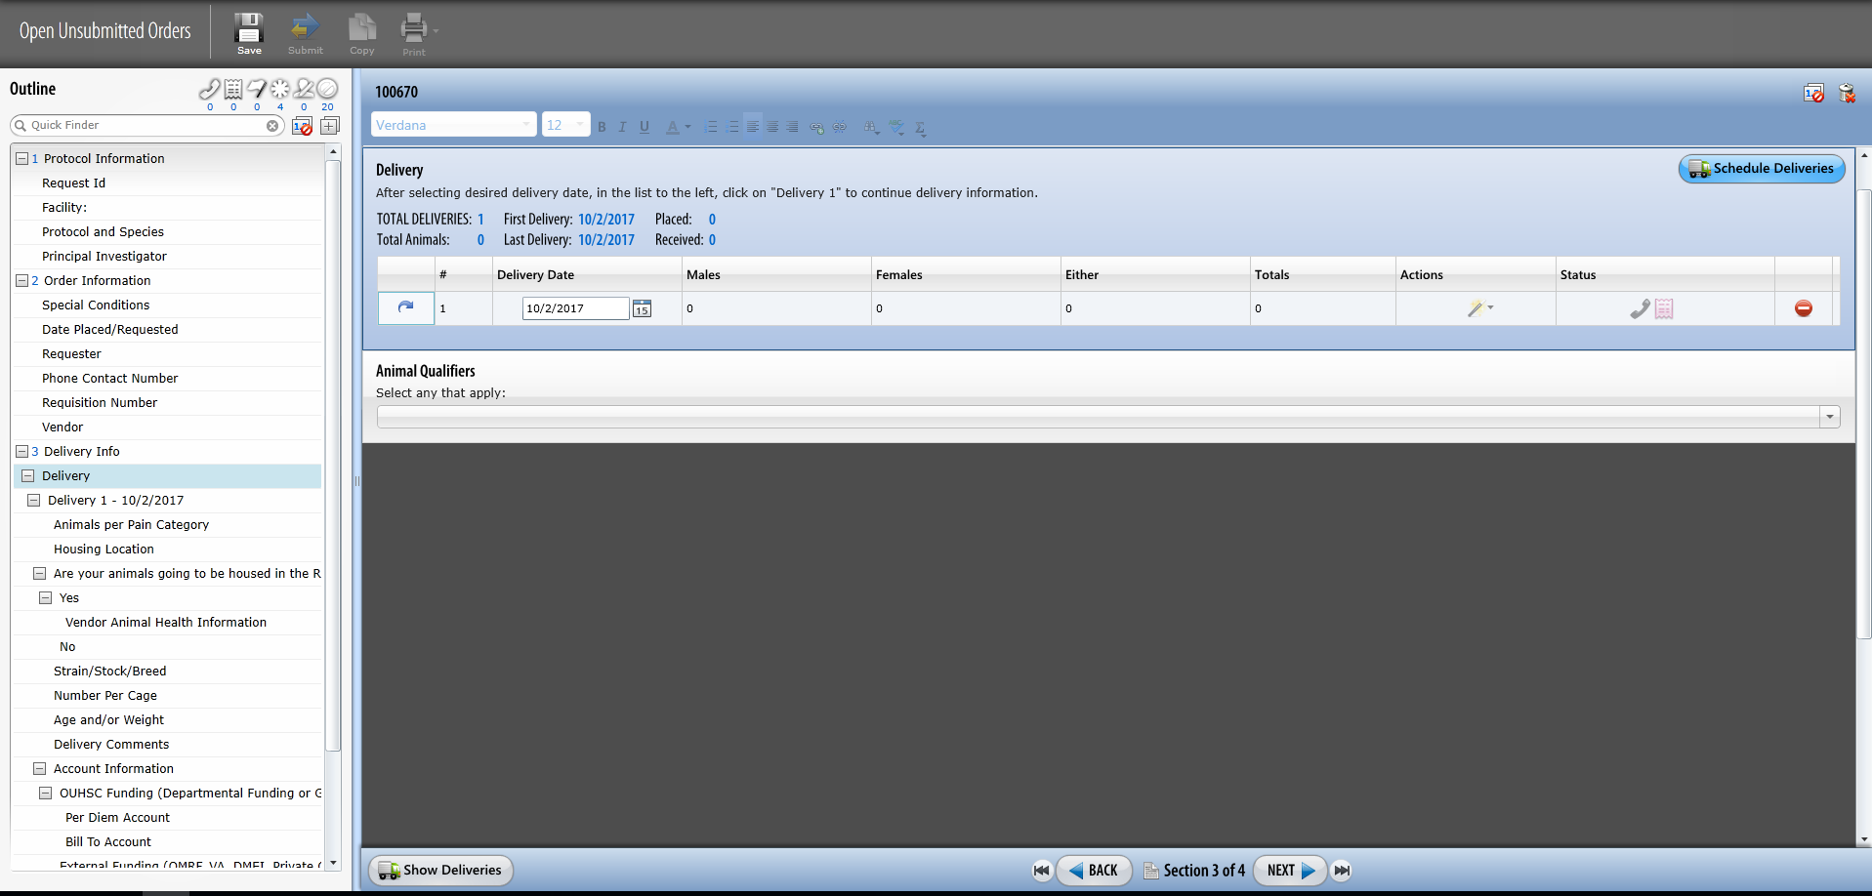
Click on the blue arrow to enter the order information.
If you don’t see this information, please hit the “save” button before trying to continue.

Slide 16
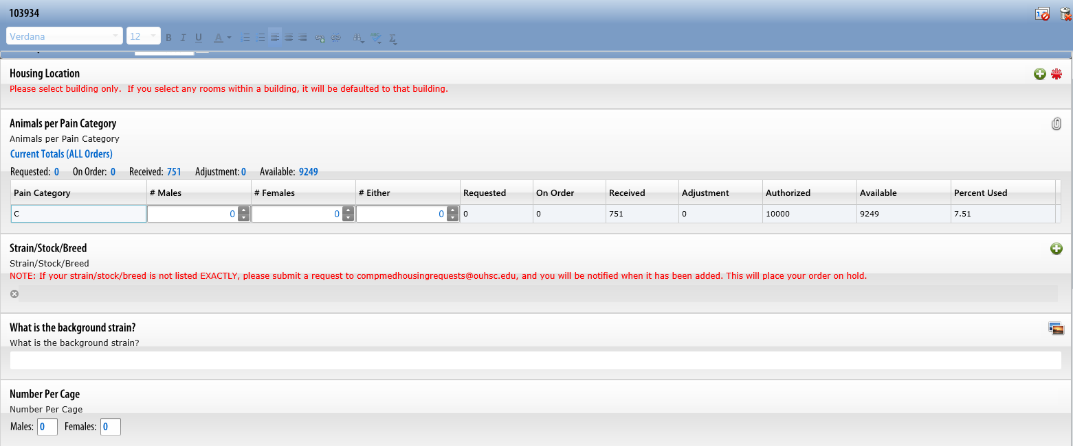
If you are placing an order to be housed in the Rodent Barrier Facility, please note that the mice will be housed in quarantine, if approved.
If your strain, stock, or breed are not listed, submit a request to compmedhousingrequests@ouhsc.edu, you will be notified when it has been added.
Please contact CMAnimalImportsExport@ouhsc.edu for questions on quarantine housing.

Slide 17
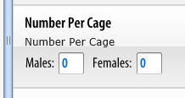
Standard mouse cages have 5 mice per cage, and standard rat cages have 2 rats per cage.
If you have special needs and want animals housed separately, please choose 1 per cage.

Slide 18
If the account you wish to use for per diem or bill to is not showing up please contact CompMedHousingRequests@ouhsc.edu to have the account added into TOPAZ.
Please be able to provide a full account number.

Slide 19
Standard mouse cages have 5 mice per cage, and standard rat cages have 2 rats per cage.
If you have special needs and want animals housed separately, please choose 1 per cage.

Slide 20
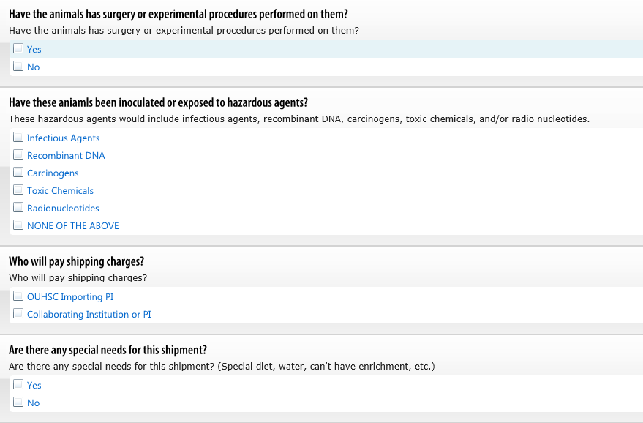
Section 3 continued:
Answer all sections listed.
Shipping courier services used will be at the discretion of DCM and the sending institution.
If you are unsure of any question listed, please contact CMAnimalImportsExport@ouhsc.edu

Slide 21
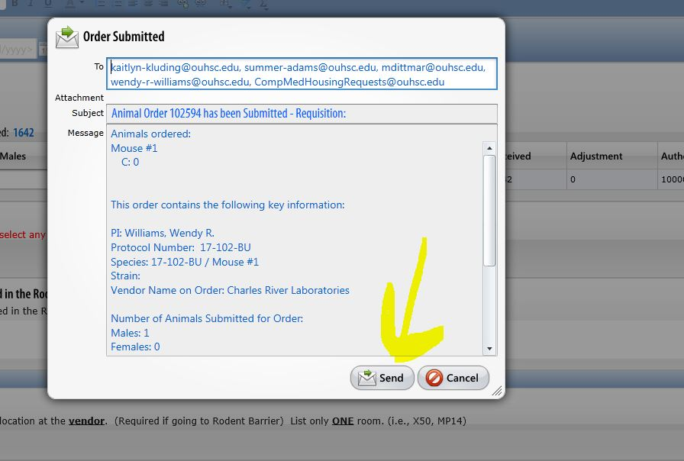
SUBMITTING AN ORDER EXAMPLE:
If you do not select the “Send” button DCM will not be notified your order has been submitted for processing.

Slide 22
AFTER IMPORT SUBMISSION IS RECEIVED
DCM will review the Import submission, if there are any questions or clarification needed, you and your lab contact will be notified via email.
Once contact begins with the shipping institution the PI and PI’s lab contact will be on the communication emails regarding their request.
If at anytime you have questions or need to know where we are at in the process, contact CMAnimalImportsExport@ouhsc.edu

